Slide 1
Front
Heidi
Jessie
Brenda
Linus
Jessica
Steven
Nicole
Waitlisted/
Auditors

Slide 2
Announcements
No lecture next Monday :o — (We'll still be meeting on Wednesday)
Post questions on Piazza for a quicker response, please (Really hard to debug over email) Email us if you have logistical questions
Common Bugs and Errors
Do NOT rename your zip file when submitting to ‘hw-2.zip’
Make sure your HTML file is properly named ‘index.html’
Ensure your image names are properly referenced (it’s CaSe-SeNsItIvE!)

Slide 3
Hands on: CSS, Selectors, and Pseudo-Selectors
Week 2

Slide 4
strawpoll.me/17426682

Slide 5
First, a Quick Recap on CSS

Slide 6
HTML and CSS: At a Glance
<!doctype html>
<html>
<head>...</head>
<body>
<p>Welcome to WDD!</p>
<img src=”wdd.png” />
</body>
</html>
body {
width: 200px;
text-align: center;
}
p {
font-size: 32px;
color: green;
font-family: Karla;
}
HTML
CSS

Slide 7
Selectors
We use selectors to describe (or “select”) the HTML elements for which we want to create rules. Just like HTML tags, they can describe parent-child relationships, ids, classes, and attributes.
In this case, we:
Select the body tag
Select all p tags
Apply rules to each!
body {
width: 200px;
text-align: center;
}
p {
font-size: 32px;
color: green;
font-family: Karla;
}
CSS

Slide 8
Chaining Selectors
Sometimes, we want our selector to be more specific than just one tag name, class, id, attribute, or other piece of information. When that’s the case, we can chain selectors together! A few examples:
div.hello selects divs with at least class=”hello”
div.hello.world selects divs with at least class=”hello world”
#hi.there selects elements with id=”hi” and at least class=”there”
p#text selects the p tag with id=”text”
We’ll also show you some more selectors you can use soon!

Slide 9
Rules
CSS works declaratively--that is, it tells the browser, “I declare that is true for . ,” where is our set of rules, and . is our selector.
How do we define rules?
The property tells us what we are changing about the element (e.g. padding, color, font-size).
The value tells us how we want to change that property (e.g. 10%, red, 20px);
body {
width: 200px;
text-align: center;
}
p {
font-size: 32px;
color: green;
font-family: Karla;
}
x
y
x
y
CSS

Slide 10



State your business!
(Please indulge the bad pun.)
Notes:
Just as we define rules for our webpage, we also define rules for any system. You might think of the weather--you have a system that can be sunny, rainy, or snowy, or somewhere in between, and if you had a magical weather machine, you could determine how that system behaves. Systems aren’t static--they’re always changing, just like the seasons fade and the clouds drift in and out of a landscape! So how do we understand the changes that occur on our webpage? We can use the concept of state!

Slide 11
Where does state come from?
State in web pages and web applications can come from many places:
How the user interacts with the website (clicking, hovering, etc.)
How the webpage is displayed (which browser is being used, the size of the window, what time it is, the scroll position, etc.)
Data coming from the backend (don’t worry about this for now!)
We’ll be most focused on the first source of state in this class--ask us about the rest during lab if you’re curious!

Slide 12
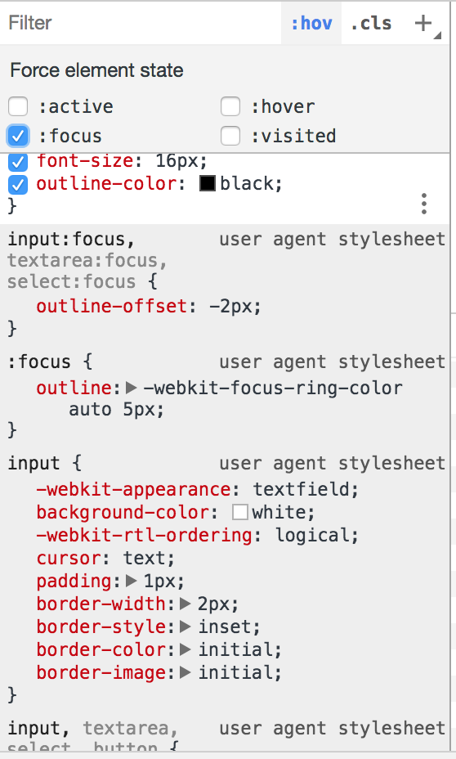
State in CSS: Pseudo-Selectors!
Pseudo-selectors allow us to select only the elements on a webpage that have a specific state. A few examples:
To select for something that the user is hovering over, use :hover.
To select a link that the user has already visited, use :visited.
/* Hover over element */
.item:hover { /* ... */ }
/* Element in “focus” */
.item:focus { /* ... */ }
/* Unvisited link */
.item:link { /* ... */ }
/* Link already visited */
.item:visited { /* ... */ }
CSS

Slide 13
Even more pseudo-selectors!
Pseudo-selectors can do much more than understand how a user interacts with a webpage--they also can help us understand parent-child relationships (alongside other selectors that we’ve not yet taught you).
:nth-child(n) selects the nth element in a container
:only-child selects elements that are the only child of their parent
:empty selects elements that have no children
And more! Read the full w3schools spec here (you don’t need to know all of this!).

Slide 14
CSS Selector Game (with Sushi!)
flukeout.github.io/

Slide 16
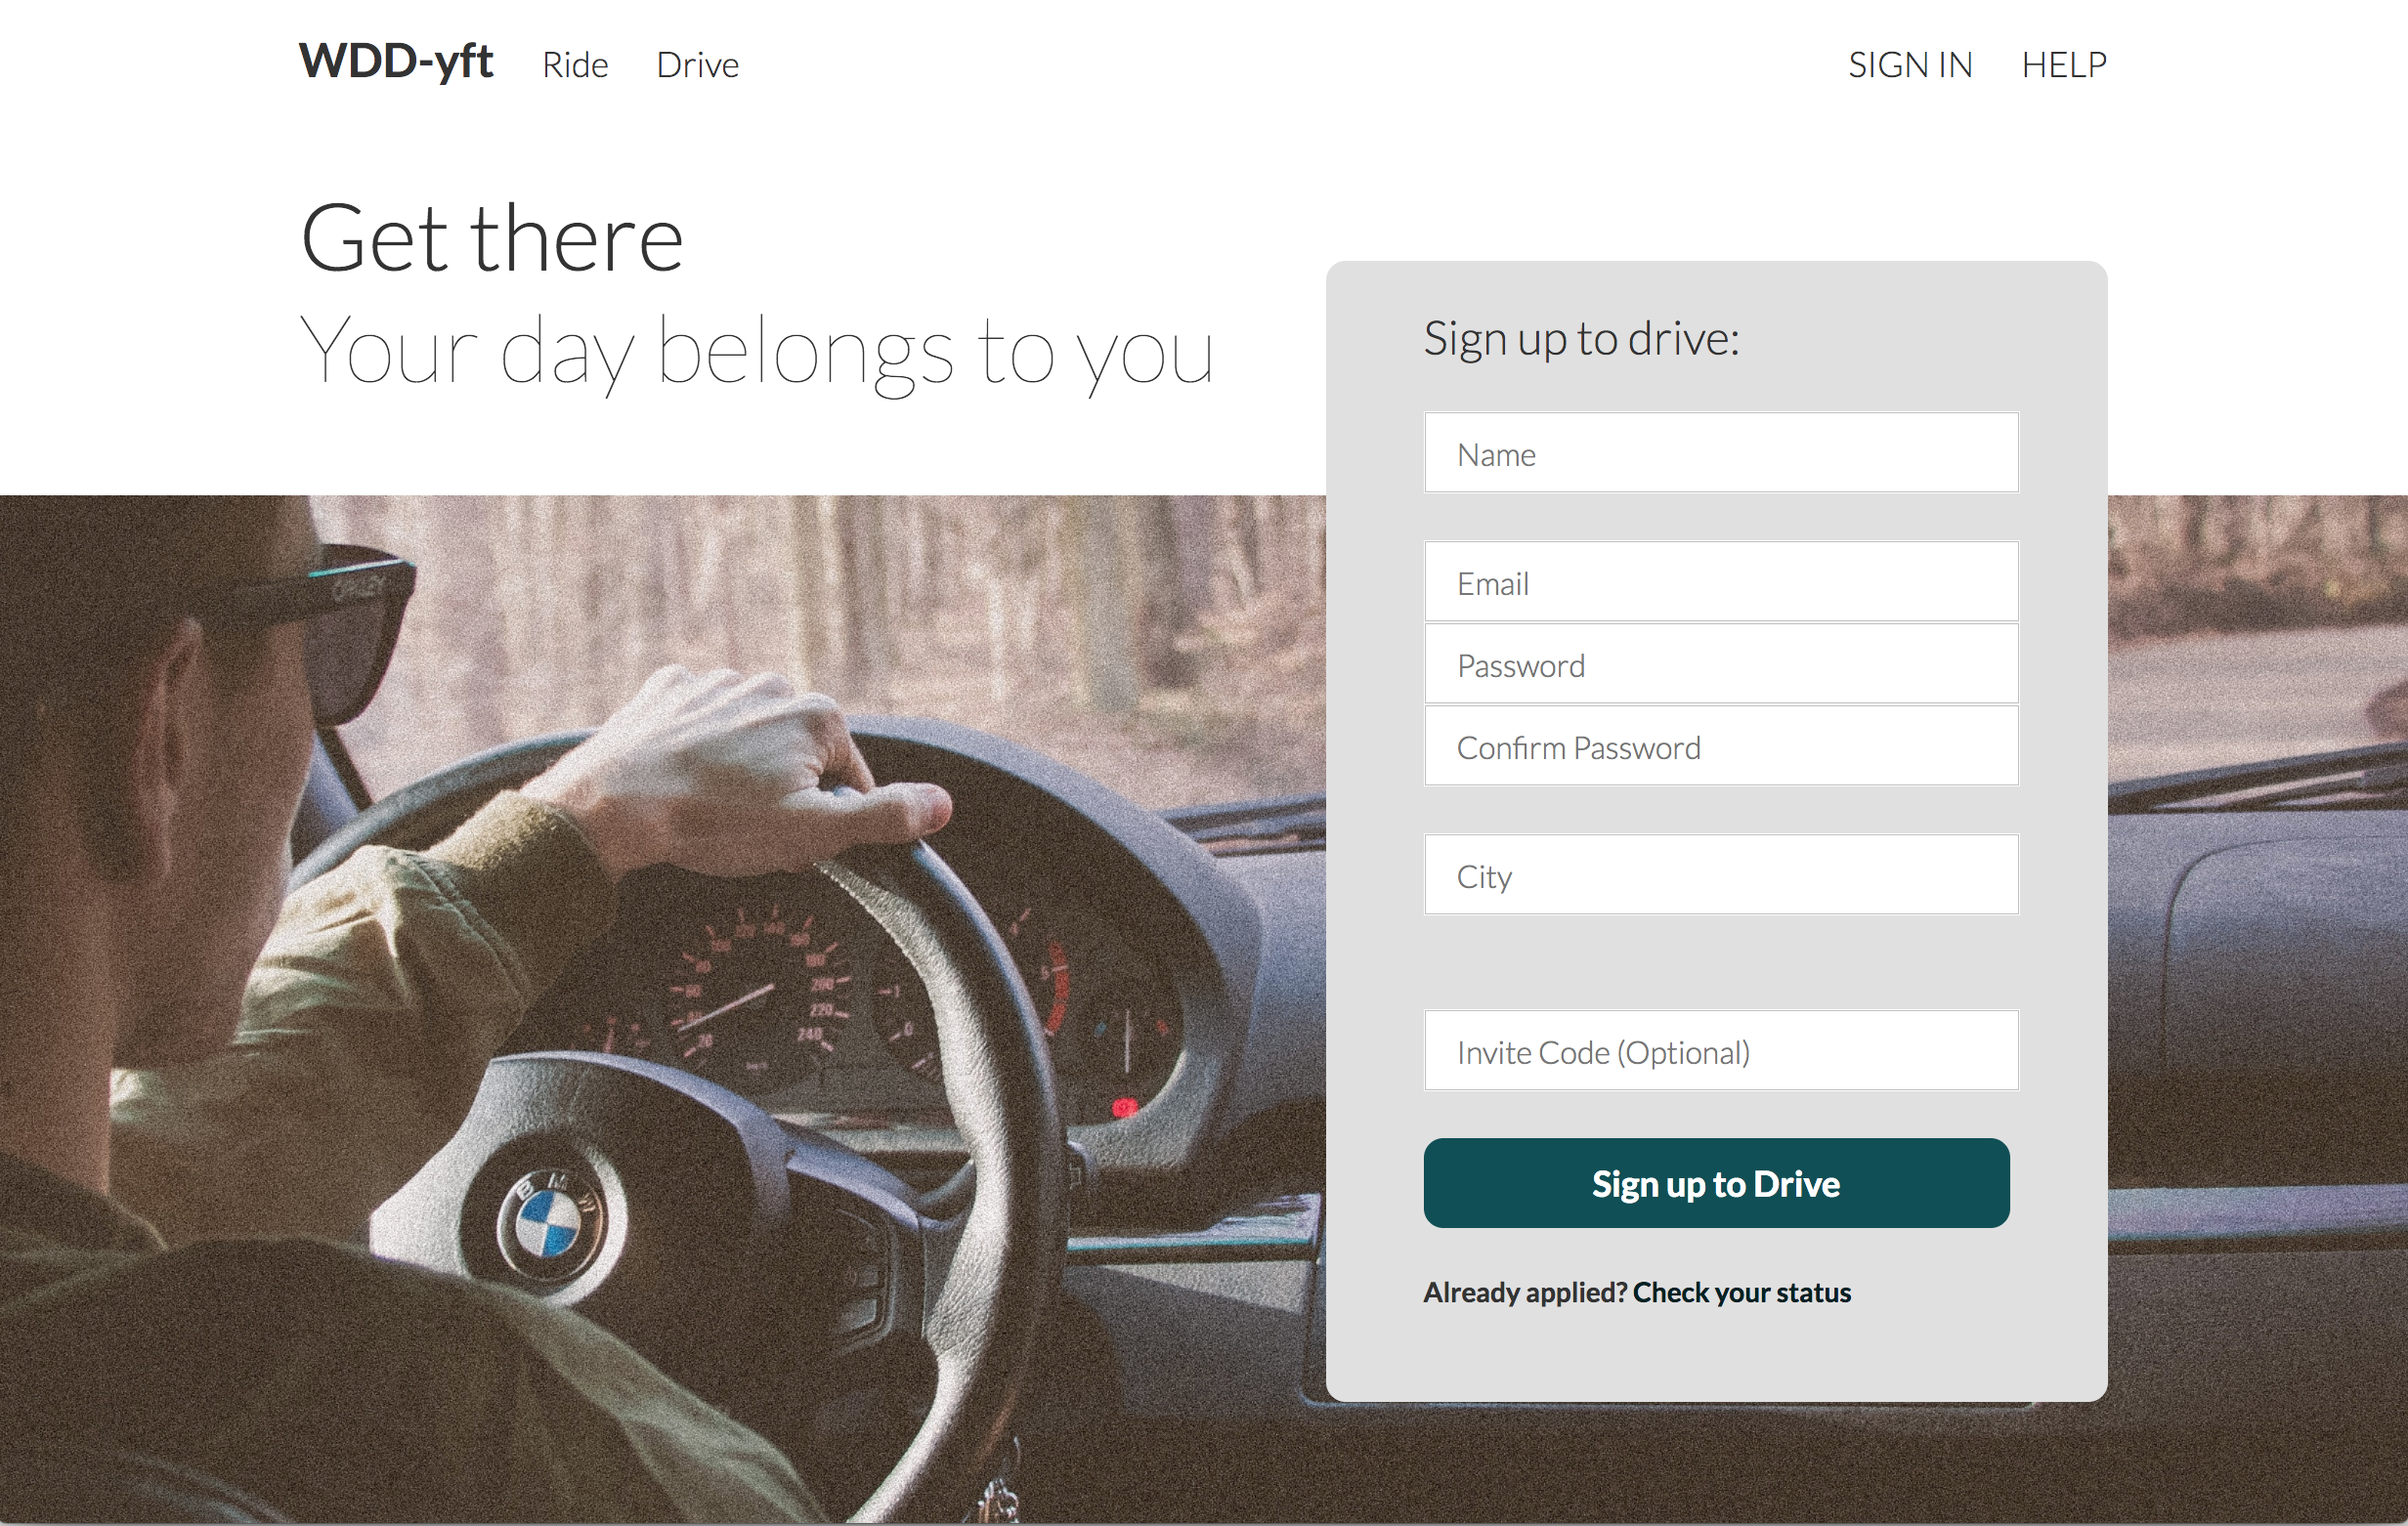

Lab 2: WDD-yft

